Slide 1


Usman
29th March, 2025

Slide 2

Outline
Executive Summary
Introduction
Methodology
Results
Conclusion
Appendix

Slide 3
Executive Summary
This project involved collecting SpaceX data using API and webscraping using BeautifulSoup. The data was then stored in a dataframe and processed before performing exploratory data analysis using SQL queries and charts. We then created interactive dashboards and maps to provide visual feedback. We then used the data to build a predictive model using machine learning.
We realized Kennedy Space Center Launch Maps had the highest success rate. The largest number of successful launches was also attributed to KSC LC-39A. Payload Range(kg) of 2k to 4k had the highest launch success rate. We even compared other factors such as booster versions and proximity of launch sites to railways, highways, and etc. A bunch of relationships were also evaluated using plots and charts such as orbit type vs flight number, payload mass vs orbit type, flight number vs launch site, and etc. Many significant observations were made such as with increase in flight number we saw that the first stage is more likely to land successfully.

Slide 4
Introduction
In this project, we predicted if the Falcon 9 first stage will land successfully. SpaceX advertises Falcon 9 rocket launches on its website, with a cost of 62 million dollars; other providers cost upward of 165 million dollars each, much of the savings is because SpaceX can reuse the first stage. Therefore if we can determine if the first stage will land, we can determine the cost of a launch. We compared different factors using data analysis to find out which factors contributed towards a successful launch and otherwise.

Slide 5

Section 1

Slide 6
Methodology
Executive Summary
Data collection methodology:
API and webscraping libraries were used to collect data
Perform data wrangling
Processed the data and columns to help us in our exploratory analysis
Perform exploratory data analysis (EDA) using visualization and SQL
Perform interactive visual analytics using Folium and Plotly Dash
Perform predictive analysis using classification models
Used training and testing data to tune and evaluate classification models

Slide 7
Data Collection – SpaceX API
First we imported Python libraries such as Pandas, NumPy, Requests and Datetime.
Then we defined a series of helper functions that helped us use the API to extract information using identification numbers in the launch data such as learning the booster name from the rocket column.
We then requested the rocket launch data from SpaceX API using its URL.
We decoded the response content as a Json using .json() and turned it into a Pandas dataframe using .json_normalize().
A lot of the data was just IDs so we used the API again to get information about the launches using the IDs given for each launch.
This data was then used to create another dataframe.
https://github.com/UsmannKhan/ibm-applied-ds/blob/main/jupyter-labs-spacex-data-collection-api.ipynb

Slide 8
Data Collection - Scraping
Installed libraries – BeautifulSoup and Requests
Requested the Falcon9 Launch wiki page before creating a BeautifulSoup object and parsing the table to create a dataframe
https://github.com/UsmannKhan/ibm-applied-ds/blob/main/jupyter-labs-webscraping.ipynb

Slide 9
Data Wrangling
First we calculated the number of launches on each site by using the method value_counts() on the column LaunchSite.
Then we calculated the number and occurrence of the dedicated orbit each launch aims to be in, using the Orbit column
Then we used the Outcome column to determine the number of landing outcomes and assigned it to the variable landing_outcomes
A list was then created where an element was zero if the corresponding outcome was bad and vice versa. This was assigned to the variable landing_class.
One means the first stage landed successfully and zero means that it did not.
A new column class was then added to the dataframe which could be used to determine the success rate
https://github.com/UsmannKhan/ibm-applied-ds/blob/main/labs-jupyter-spacex-Data%20wrangling.ipynb

Slide 10
EDA with Data Visualization
To compare the first relationship between flight number and launch site, a scatterplot was created. Another scatterplot was plotted to visualize the relationship between Payload Mass and Launch Site. For the relationship between success rate of each orbit type, we created a bar chart. A scatterplot was used again to visualize both, the relationship between Flight Number and Orbit type and between Payload Mass and Orbit type. We used a line graph to visualize the yearly trend of launch success
https://github.com/UsmannKhan/ibm-applied-ds/blob/main/edadataviz.ipynb

Slide 11
EDA with SQL
First we used a SELECT statement to display the names of the unique launch sites in the space mission
Then we used another SELECT statement with a WHERE clause to display 5 records where launch sites begin with the string ‘CCA’.
We then used a query to display the total payload mass carried by the boosters launched by NASA (CRS) before querying the average payload mass carried by booster version F9 v1.1.
Queried the date when the first successful landing outcome in ground pad was achieved using the min function.
Listed the total number of mission outcomes along with names of boosters and their versions with varying payload mass and other conditions.
Listed records for different years and ranked the landing outcomes in a particular timeframe
https://github.com/UsmannKhan/ibm-applied-ds/blob/main/jupyter-labs-eda-sql-coursera_sqllite.ipynb

Slide 12
Build an Interactive Map with Folium
First we marked all launch sites on a map using the longitude and latitude, after creating the folium Map object. We added a folium.Circle and folium.Marker so each launch site is circled and labeled. We then used a MarkerCluster object to mark the successful and failed launches at each site. MarkerCluster is a good way to simplify a map containing many markers having the same coordinate. Then to calculate the distances between a launch site to its proximities, we first added a MousePosition to get the coordinates for a mouse over a point on the map. Then we used this object to calculate the distance to the closest coastlines, railways, and highways and drew a PolyLine to visualize that distance.
https://github.com/UsmannKhan/ibm-applied-ds/blob/main/lab_jupyter_launch_site_location.ipynb

Slide 13
Build a Dashboard with Plotly Dash
Firstly, we have a piechart that shows the total success launches for each site helping us compare the success rates. We have a dropdown menu above this piechart to select a specific launch site, helping us visualize the success and failure rates for each site. We then have a scatterplot in this dashboard visualize the correlation between Payload and success for all sites. We have a range slider above this scatterplot to adjust the Payload range (Kg).
https://github.com/UsmannKhan/ibm-applied-ds/blob/main/spacex_dash_app.py

Slide 14
Predictive Analysis (Classification)
First we created a NumPy array from the column Class and assigned it to a variable Y. We then standardized the data in X, which was a dataframe, and reassigned it to the variable X. We then split the data X and Y into training and testing data. We then created a logistic regression object before creating a GridSearchCV object with cv=10. We then fit the object to find the best parameters form a dictionary ‘parameters’. We displayed the best parameters and the accuracy on the validation data before calculating the accuracy on the test data using the method ‘score’. Lastly, we plotted a confusion matrix. We repeated these steps for support vector machine, decision tree classifier, and k nearest neighbors.
https://github.com/UsmannKhan/ibm-applied-ds/blob/main/SpaceX_Machine%20Learning%20Prediction_Part_5.ipynb

Slide 15
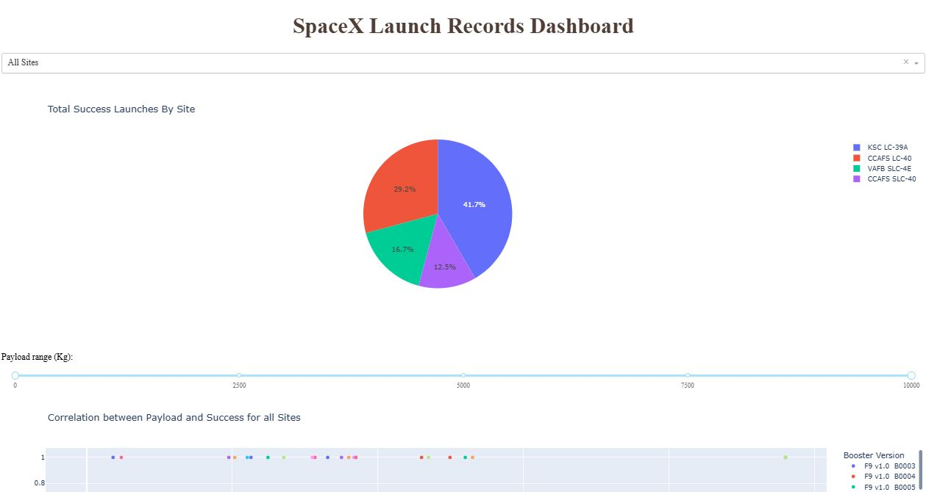
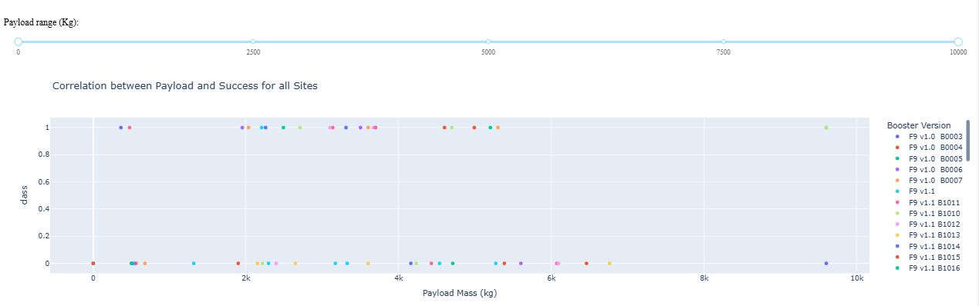
Results
Using exploratory data visualization, we observed that the success rate kept increasing from 2013 to 2019. With heavier payloads, the successful landing rate are more for Polar, LEO and ISS orbit types. However, for GTO, it’s difficult to distinguish. In the LEO orbit, success seems to be related to the number of flights. Conversely, in the GTO orbit, there appears to be no such relationship. ES-L1, GEO, HEO, and SSO have the highest success rates. For the VAFB-SLC launch site there are no rockets launched for heavy payload mass(greater than 10000). As flight number increased, the likelihood of the first stage landing successfully also increased even with more massive payloads.
With our Predictive Analysis, we found that all classification methods had the same accuracy score using the test data. Logistic regression had the lowest best score using the training data. SVM and KNN were joint second with identical best scores using the training data. Decision Tree had the highest best score value using the training data.

Slide 16

Section 2

Slide 17
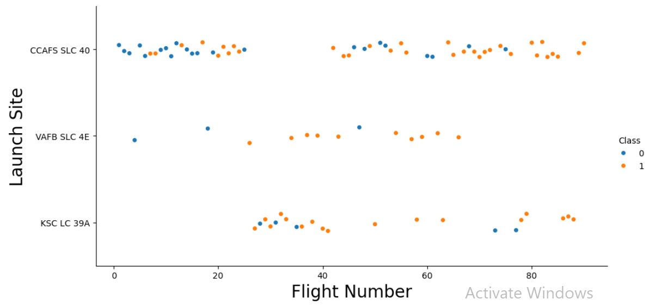
Flight Number vs. Launch Site
As the Flight Number increases, the concentration of successful landing at CCAFS SLC 40 also increases.

Slide 18
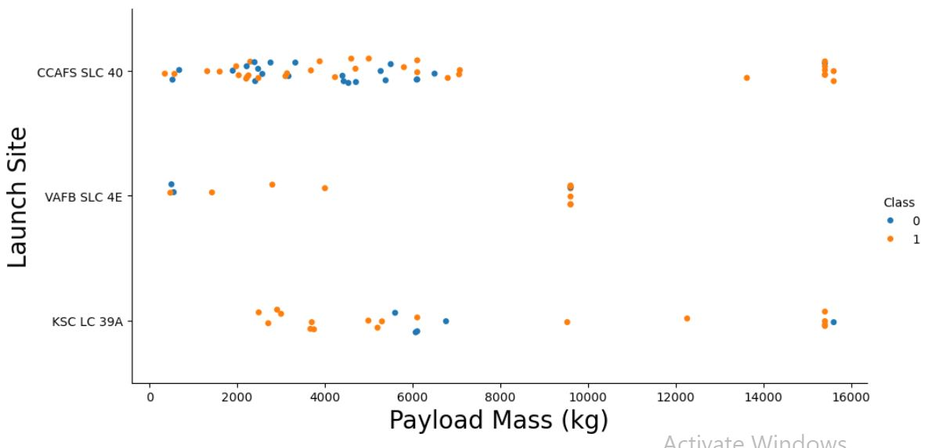
Payload vs. Launch Site
For the VAFB-SLC launchsite there are no rockets launched for heavypayload mass(greater than 10000)

Slide 19
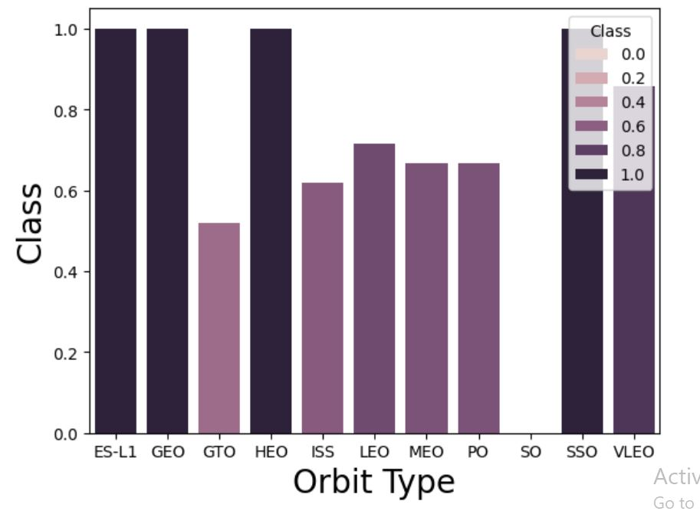
Success Rate vs. Orbit Type
ES-L1, GEO, HEO, and SSO have the highest success rates.
GTO has the lowest success rate

Slide 20
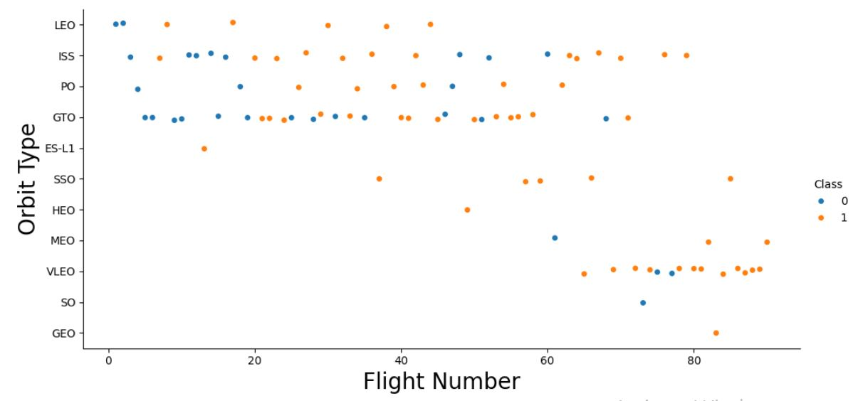
Flight Number vs. Orbit Type
In the LEO orbit, success seems to be related to the number of flights. Conversely, in the GTO orbit, there appears to be no relationship between flight number and success

Slide 21
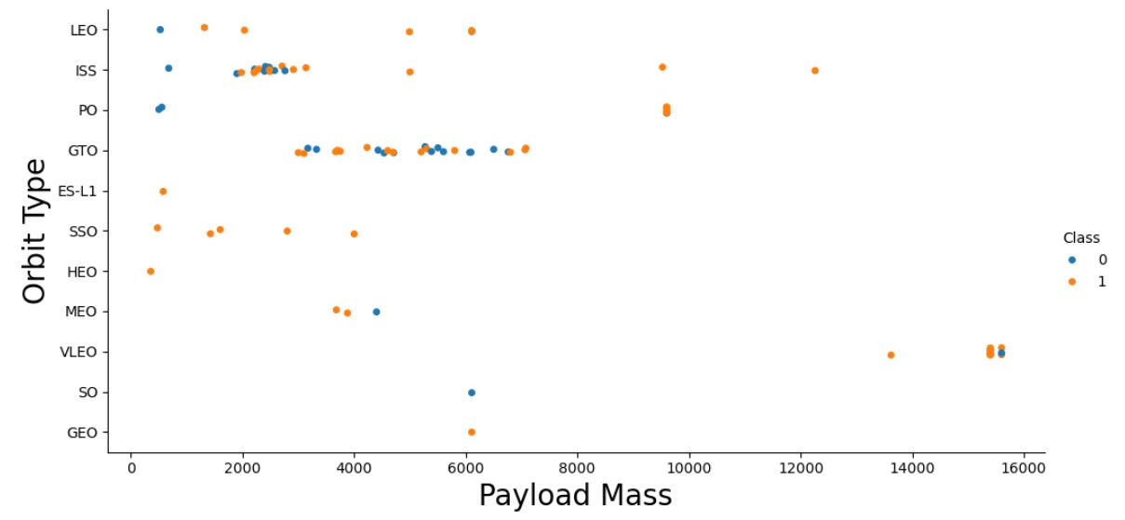
Payload vs. Orbit Type
With heavy payloads the successful landing or positive landing rate are more for Polar,LEO and ISS.
However, for GTO, it's difficult to distinguish between successful and unsuccessful landings as both outcomes are present.

Slide 22
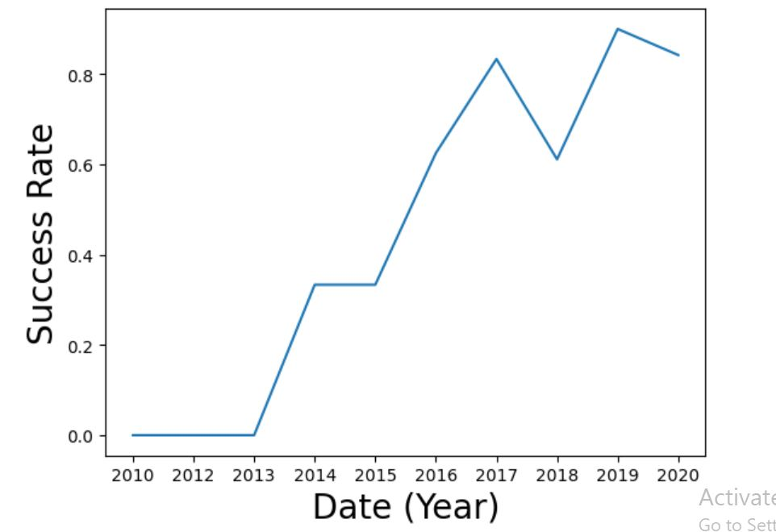
Launch Success Yearly Trend
The success rate increased at a constant rate from 2013 to 2014 before it became constant for a year.
It then continues to increase for two years before taking a dip from 2017 to 2018.
It then continues its upward trend from 2018 to 2019 before dipping again from 2019 to 2020.

Slide 23
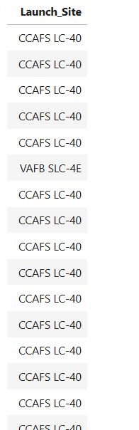
All Launch Site Names
%sql select Launch_Site from SPACEXTABLE
Select statement to select all the launch site names

Slide 24
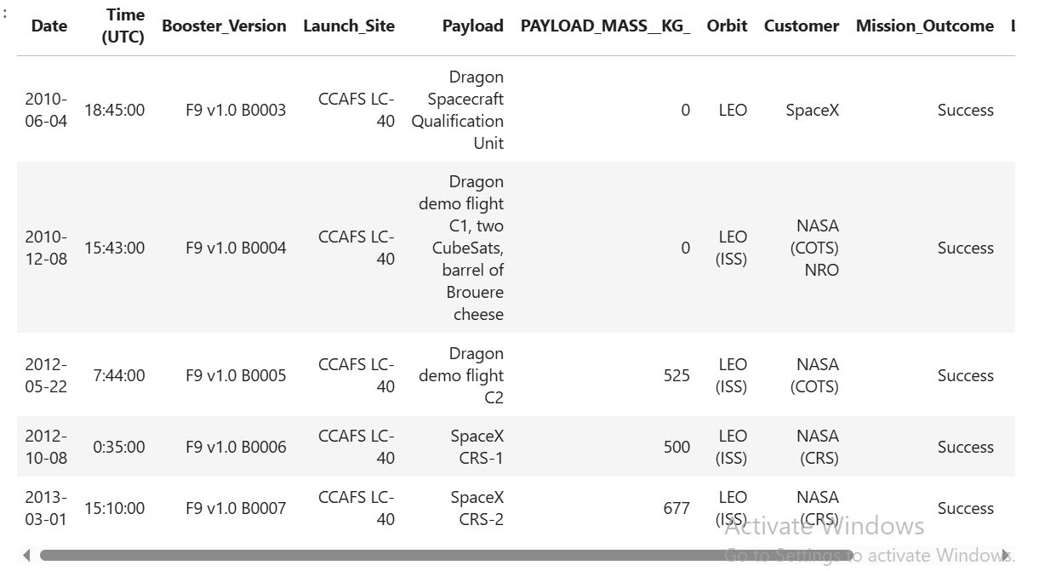
Launch Site Names Begin with 'CCA'
%sql select * from SPACEXTABLE where Launch_Site like "CCA%" limit 5
Using the WHERE clause and limiting the results to 5 only

Slide 25
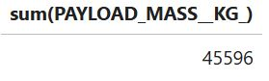
Total Payload Mass
%sql select sum(PAYLOAD_MASS__KG_) from SPACEXTABLE where Customer like "NASA (CRS)“
The sum function adds all the mass together

Slide 26
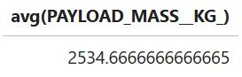
Average Payload Mass by F9 v1.1
%sql select avg(PAYLOAD_MASS__KG_) from SPACEXTABLE where Booster_Version like "F9 v1.1%“
Avg function is used to find the average in SQL

Slide 27
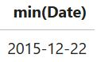
First Successful Ground Landing Date
%sql select min(Date) from SPACEXTABLE where Landing_Outcome like "%ground pad%“
WHERE clause and min function

Slide 28
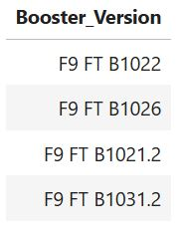
Successful Drone Ship Landing with Payload between 4000 and 6000
%sql select Booster_Version from SPACEXTABLE where Landing_Outcome = "Success (drone ship)" and PAYLOAD_MASS__KG_ > 4000 and PAYLOAD_MASS__KG_ < 6000

Slide 29
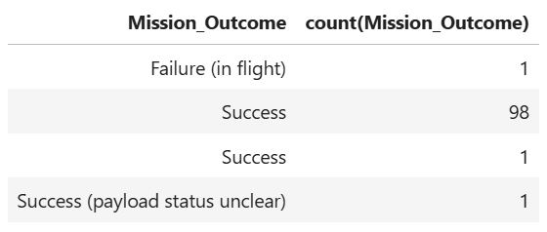
Total Number of Successful and Failure Mission Outcomes
%sql select Mission_Outcome, count(Mission_Outcome) from SPACEXTABLE group by Mission_Outcome

Slide 30
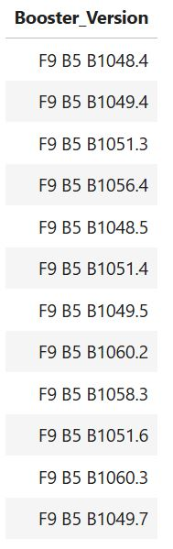
Boosters Carried Maximum Payload
%sql select Booster_Version from SPACEXTABLE where PAYLOAD_MASS__KG_ = (select max(PAYLOAD_MASS__KG_) from SPACEXTABLE)

Slide 31
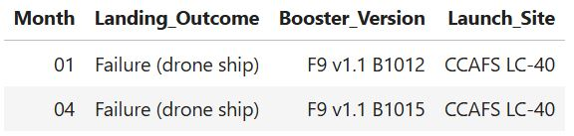
2015 Launch Records
%sql select substr(Date,6,2) as Month, Landing_Outcome, Booster_Version, Launch_Site from SPACEXTABLE where substr(Date,0,5) = "2015" and Landing_Outcome = "Failure (drone ship)"

Slide 32
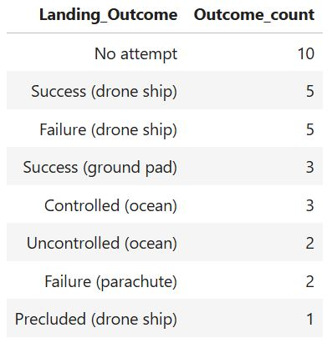
Rank Landing Outcomes Between 2010-06-04 and 2017-03-20
%sql select Landing_Outcome, count(Landing_Outcome) as Outcome_count from SPACEXTABLE where Date between "2010-06-04" and "2017-03-20" group by Landing_Outcome order by Outcome_count desc

Slide 33

Section 3

Slide 34
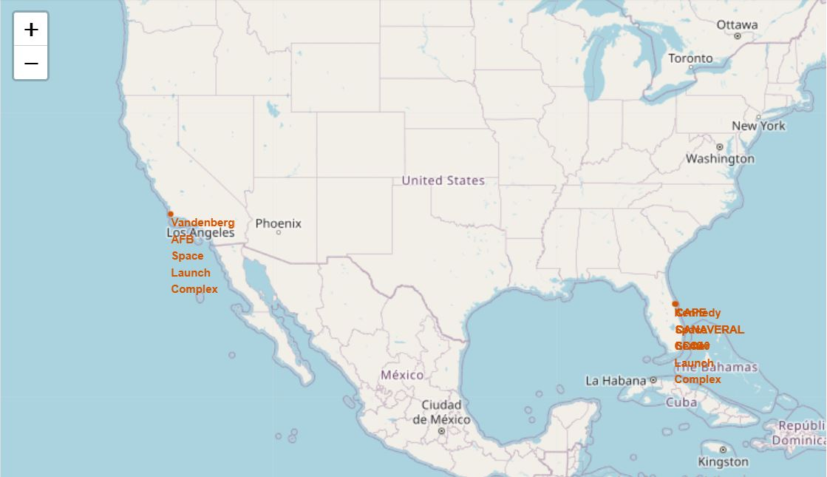
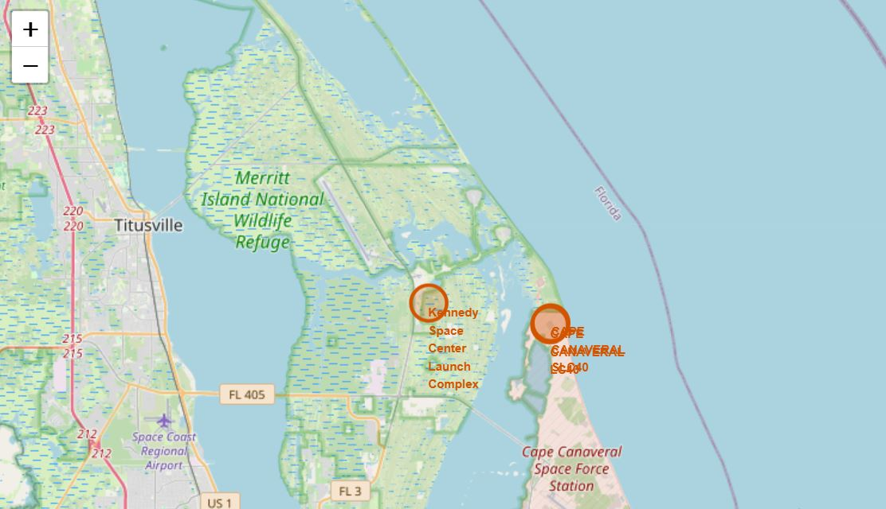
Folium – Launch Site Locations
All launch sites are next to a coastline.
CCAFS complexes and Kennedy Space
Complex are close to each other.

Slide 35
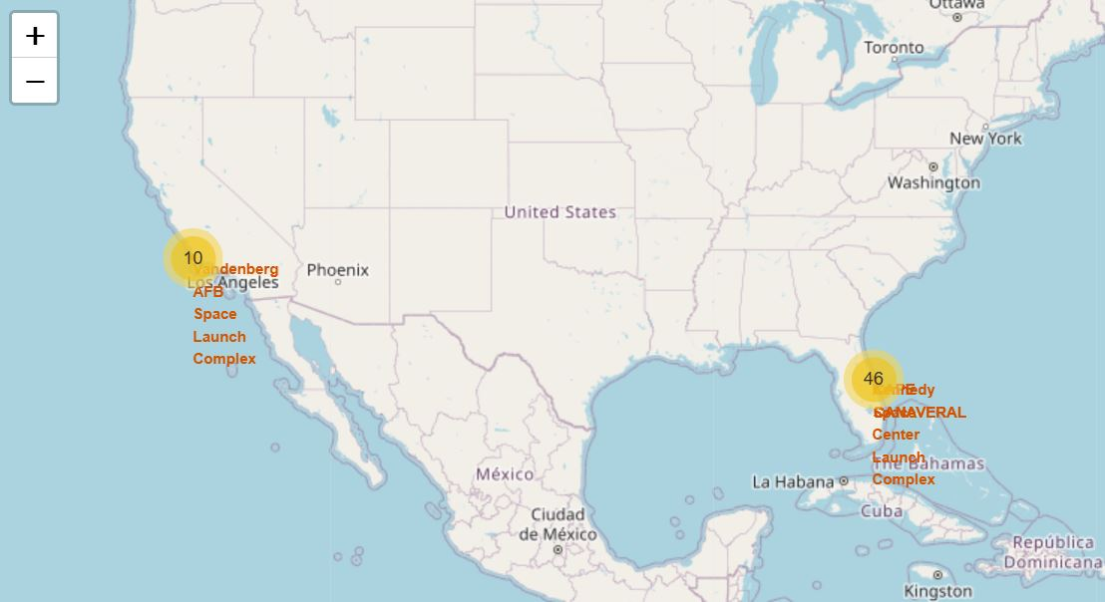
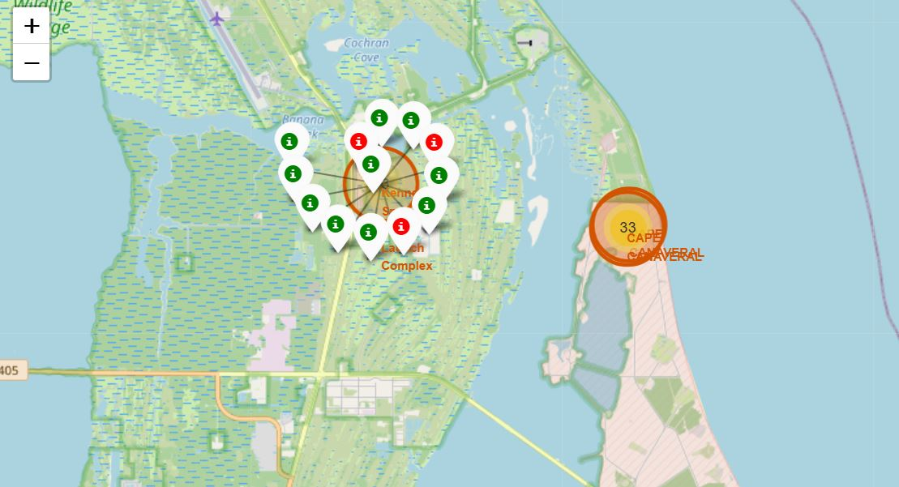
Folium – Launch Site Outcomes
Kennedy Space Launch Complex has the
highest number of successful launches.
It also has the highest success rate among
all the launch sites

Slide 36
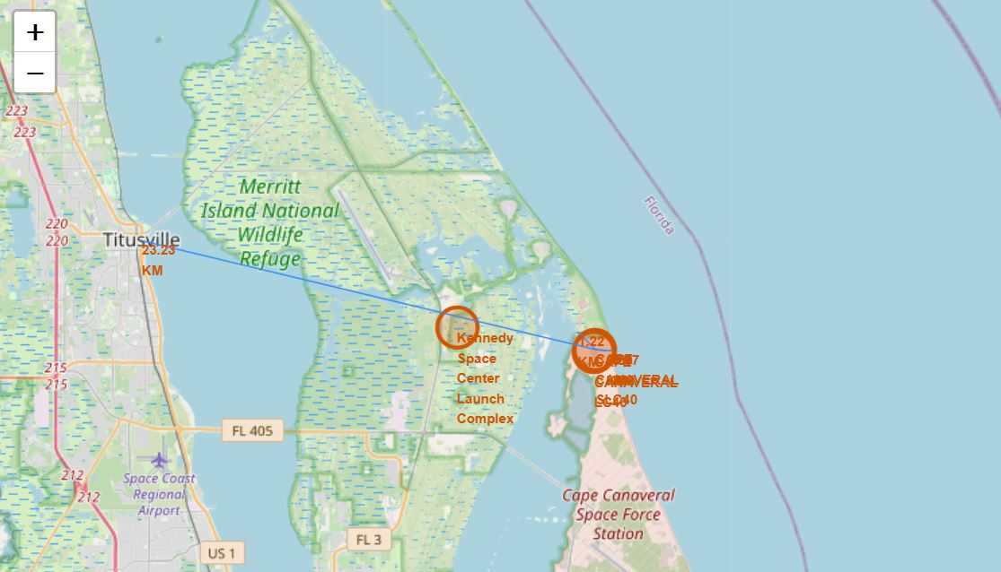
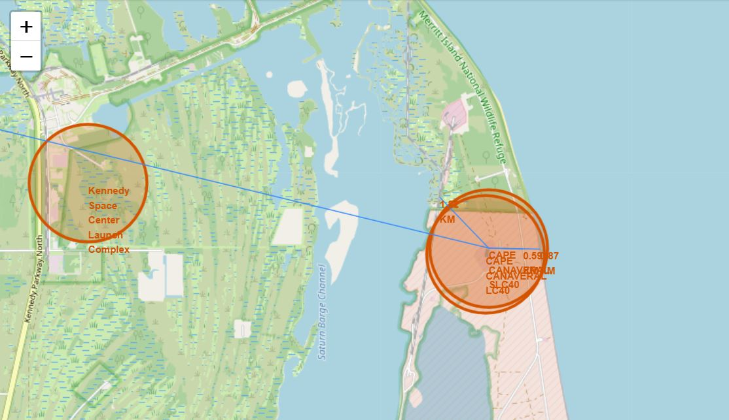
Folium – Launch Site Proximities
All launch sites are next to coastlines
Both CCAFS and Kennedy Space Complexes
are next to Titusville
The CCAFS complexes also have a railway nearby

Slide 37

Section 4

Slide 38
Dashboard Analysis
KSC LC-39A accounts for 41.7% of all successful launches which is the highest percentage among all the launch sites followed CCAFS LC-40.
VAFB SLC-4E comes at third place followed by CCAFS SLC-40 which sits at the bottom.

Slide 39
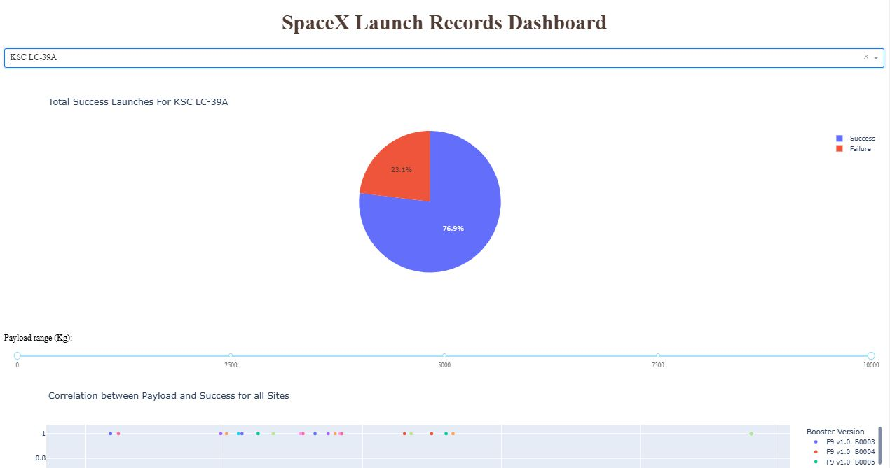
Dashboard Analysis
KSC LC-39A has the highest success rate percentage among all the launch sites.
76.9% of all launches at this complex are a success.

Slide 40
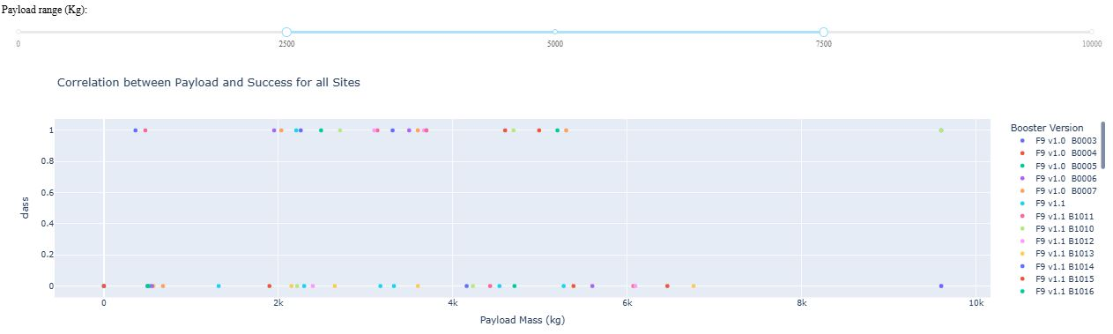
Dashboard Analysis
Payload Range(kg) of 2k to 4k had the highest launch success rate

Slide 41

Section 5

Slide 42
Classification Accuracy
With our Predictive Analysis, we found that all classification methods had the same accuracy score using the test data. Logistic regression had the lowest best score using the training data. SVM and KNN were joint second with identical best scores using the training data. Decision Tree had the highest best score value using the training data.

Slide 43
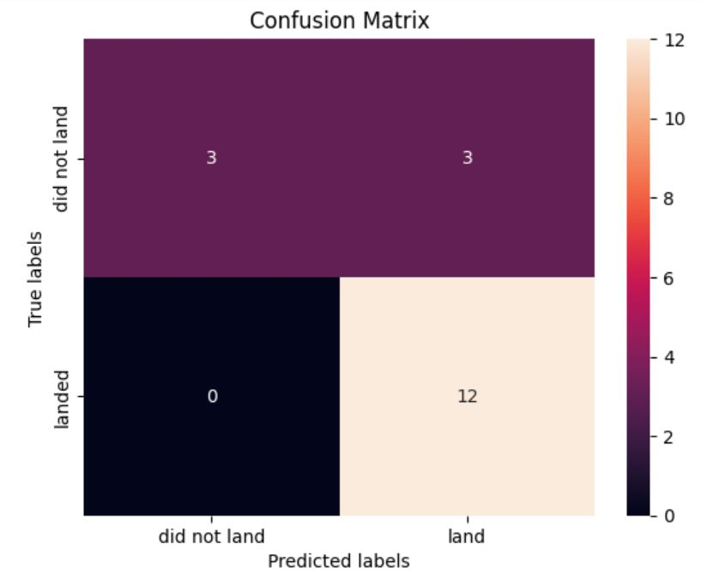
Confusion Matrix
The number of true positives are 12 (True label is landed and predicted label is also landed)
There are 3 false positives (True label is not landed and predicted label is landed)

Slide 44
Conclusions
KS LC-39A is the best site for rocket launch
Payload mass range of 2k to 4k (kg) has the highest probability of success
ES-L1, GEO, HEO, and SSO orbit types have the highest success rates.

Slide 45
Appendix
https://github.com/UsmannKhan/ibm-applied-ds/blob/main/spacex_launch_dash.csv

Slide 46


